Slide 1

UPRM INVOLVEMENT and OBSERVATIONS
Pedro Resto
Erick & Melanie Gonzalez
November 1st, 2023

Slide 2
Agenda
UPRM Team
Logistics Quality Management System (L-QMS)
IIoT as a Complement to L-QMS
Dashboard Effectiveness
Path Forward
Q&A

Slide 3
UPRM Team
InIn 4079 (Capstone Project) – offered every semester
InIn 5006 (Systems Engineering) – offered in Fall 2023
InIn 4996 (Special Topics) – offered based on needs
Dr. Pedro Resto, professor of Industrial Engineering

Slide 4
L-QMS
Logistics Quality Management System (L-QMS)
Focus: L-QMS for the handling of products requiring cold temperature
Who owns the system (external to plants) – DDEC, PRMA, UPRM
Who identifies the resources to be certified (trucking mgmt/owners & truckers; highly frequent changes) – Mfg plants
Who maintains the roster of certified resources - UPRM
Who keeps documentation updated - UPRM
Who develops & offers training and certification - UPRM
How is training offered – Web-based / videos

Slide 5

IIoT as a Complement to L-QMS
Even though IATA reports huge losses due to temperature excursions in healthcare (∼USD 35B), how much can be linked to PR shipments?
Let’s monitor temperature and activate alarms when temperature variations occur.
Let’s keep track of temperature violations by carrier to request corrective actions from offenders.

Slide 6
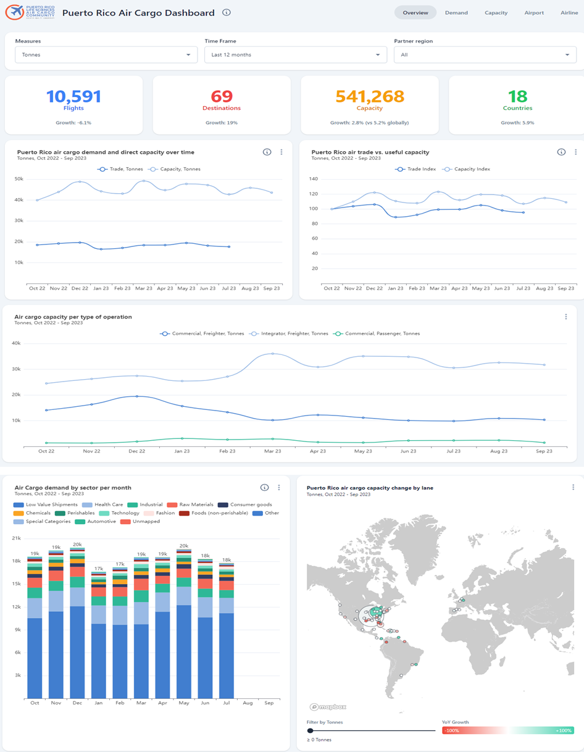
Dashboard Effectiveness

Slide 7
Dashboard Effectiveness
Need to:
Define relevant KPI’s (to focus on improvement).
Isolate relevant inbound and outbound activity.
Define transshipment tactics (e.g. Asia→Alaska, Alaska→US)
PR inbound tactics (e.g. ?→BQN, BQN→LATAM).
PR outbound tactics (SJU→?, BQN→?)
How can plants collaborate/coordinate in inbound and outbound activities so that we can increase direct flights?

Slide 8
Possible capstone projects (for next semester)
Path Forward
Team for L-QMS & IIoT definition
Team for Dashboard tactics definition
L-QMS deployment
IIoT solution selection
Inbound and outbound tactics deployment
Cold storage building space availability analysis

Slide 9
Any Questions?
If we keep doing the same things, we should NOT expect different results!
If we don’t improve, PR will continue losing competitiveness…

